Slide 1
Scientific collaboration networks at the University of Rijeka
Ana Meštrović, Slobodan Beliga, Sanda Martinčić-Ipšić
Department of Informatics
University of Rijeka
15th Workshop on “Software Engeneering Education and Reverse Engineering”
Bohinj, Slovenia, 23th-30th August 2015

Slide 2
Overview
Part I
Complex networks
Complex networks analysis
Part II
Experiment
Results
Conclusion & future work

Slide 3
Part I: complex networks

Slide 4
Introduction
Complex networks: graphs (networks) with specific structural properties:
small average path length,
high clustering coefficient,
community structure,
hierarchical structure,
“heavy tail” degree distribution
...

Slide 5
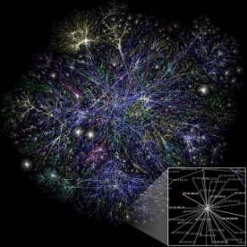
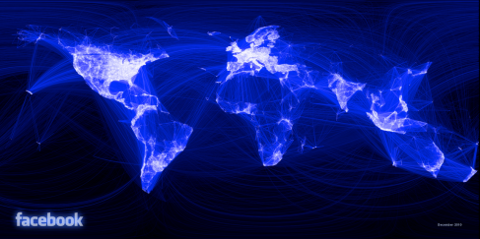
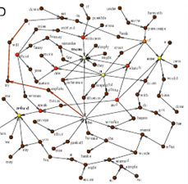
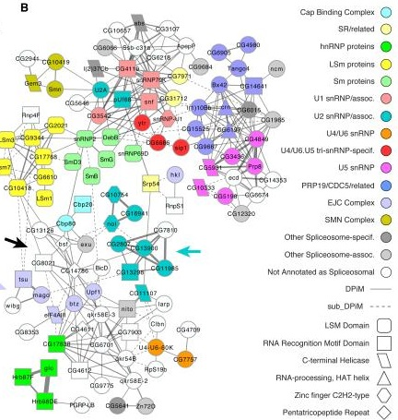
Complex networks: examples
Technological networks
Internet, infrastructure networks, transport networks, power networks, ...
Social networks
Organisation networks, collaboration networks, (on-line) social networks, epidemic spreading in complex networks, terroristic networks,....
Information networks
Web, citation networks,
semantic networks, language networks,...
Biological networks
Metabolic interactions, protein-protein interactions,
food chains,...

Slide 6
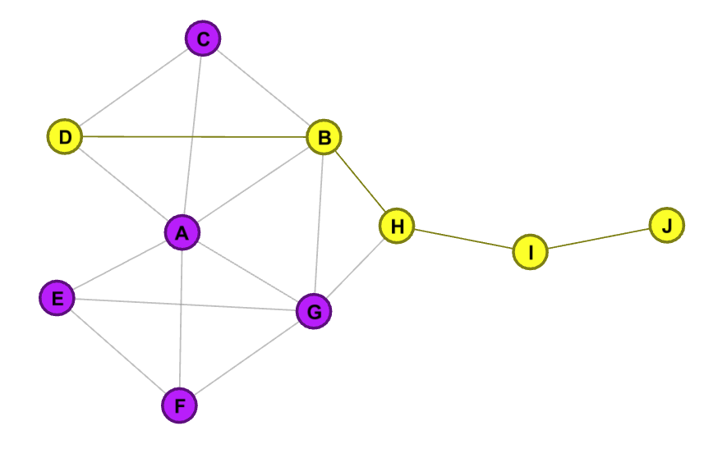
“Small-world” networks
Universal properties:
small average shortest path length
high clustering coefficient
Clustering coefficient of a node is a fraction of links between the neighbouring nodes divided by the all number of links that could possibly exist between them
Shortest path length between nodes D and J is 4.
Average shortest path length is 2.
c=0 c=1/3 c=1

Slide 7
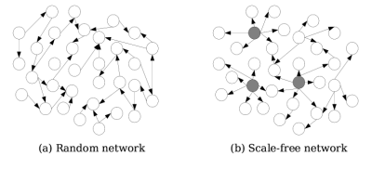
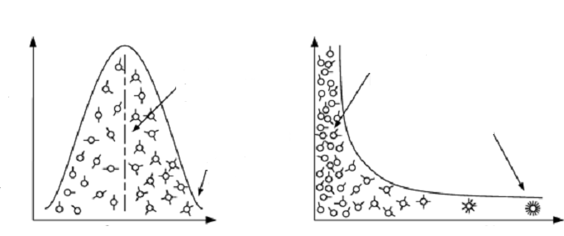
“Scale free” networks
RANDOM NETWORK
SCALE FREE NETWORK
Majority of nodes
have average
number of links
Majority of nodes
have small
number of links
Number of nodes
Small number of nodes have numer of links an order of magnitude greather than others
Small number
of nodes deviate
Number of links

Slide 8
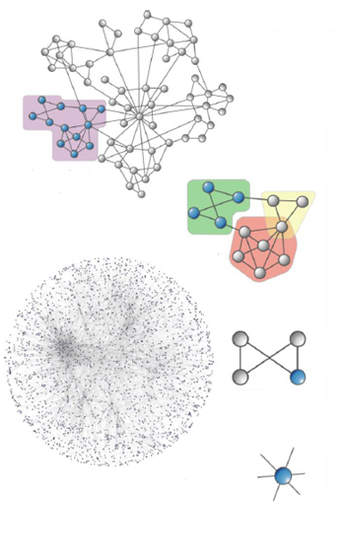
Macro-scale level analysis: average shortest path length, clustering coefficient, degree distribution, …
Meso-scale level analysis: communities detection,
Motif analysis, graphlet analysis,...
Micro-scale level analysis: centrality measures (degree centrality, betweeness centrality, closeness centrality…)

Slide 9
Macro-scale level analysis
Global network measures:
Average path length, diameter, ...
Average clustering coefficient, global clustering coefficient, ...
Density
Average degree, average strength,
Degree distribution, strength distribution, ...
Assortativity
Modularity
Number of components
...

Slide 10
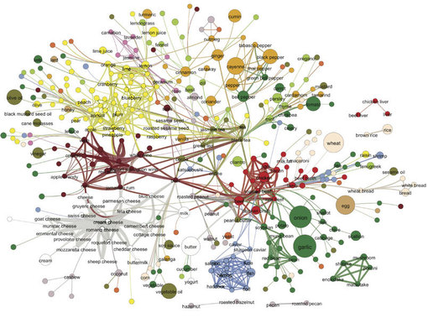
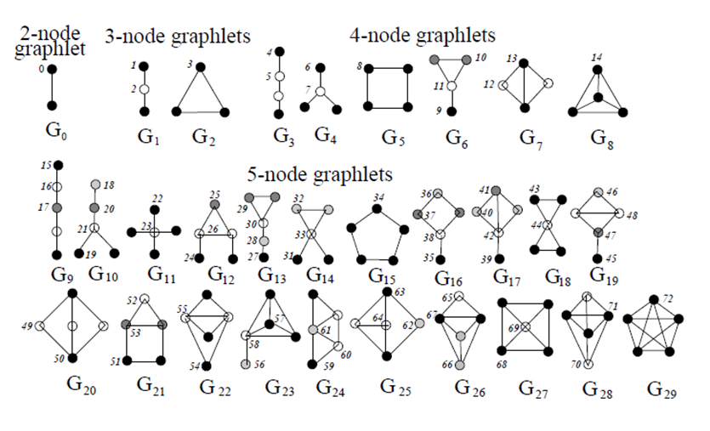
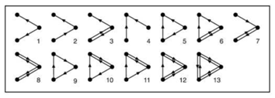
Meso-scale level analysis
Communities
Motifs
Graphlets

Slide 11
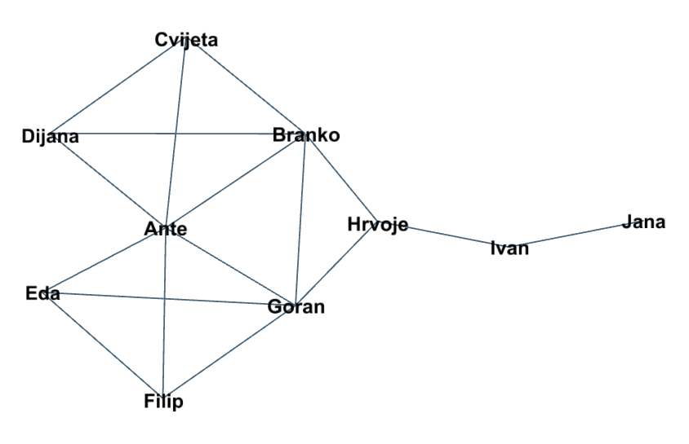
Micro-scale level analysis
Centrality measures: which node is “the most important”?

Slide 12
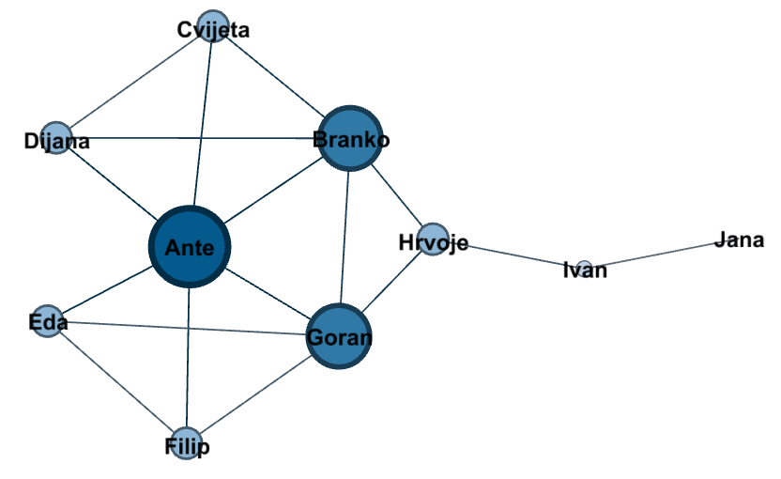
Micro-scale level analysis
Which node is “the most important”?
Degree centrality

Slide 13
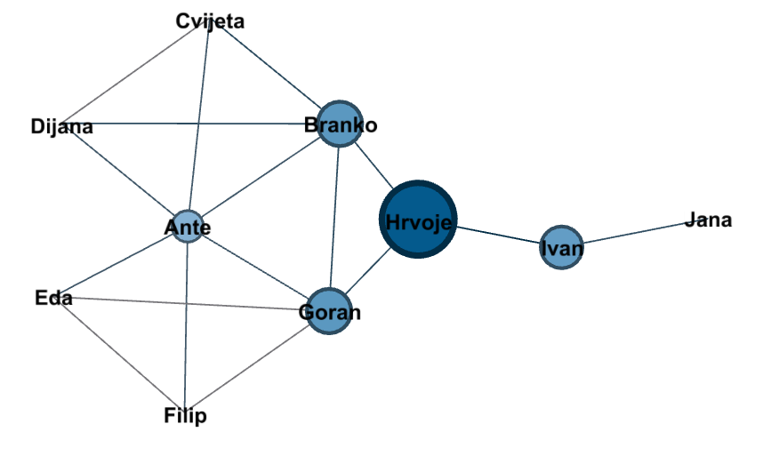
Micro-scale level analysis
Which node is “the most important”?
Betweenness centrality

Slide 14
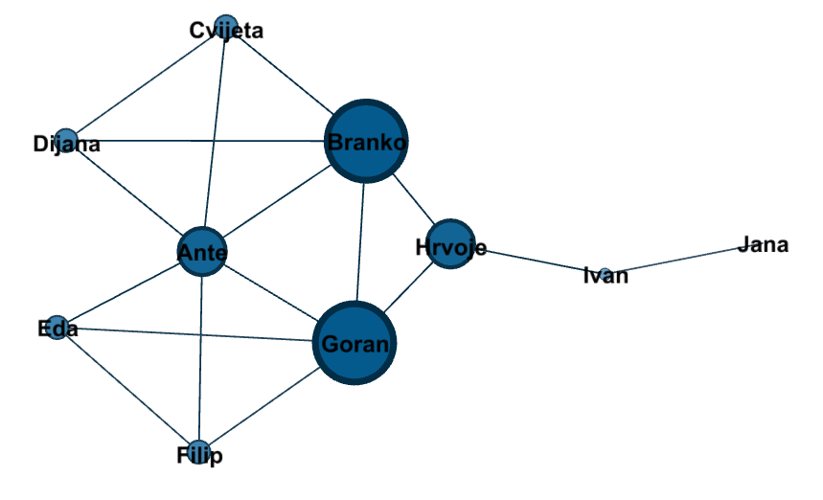
Micro-scale level analysis
Which node is “the most important”?
Closeness cenrality

Slide 15
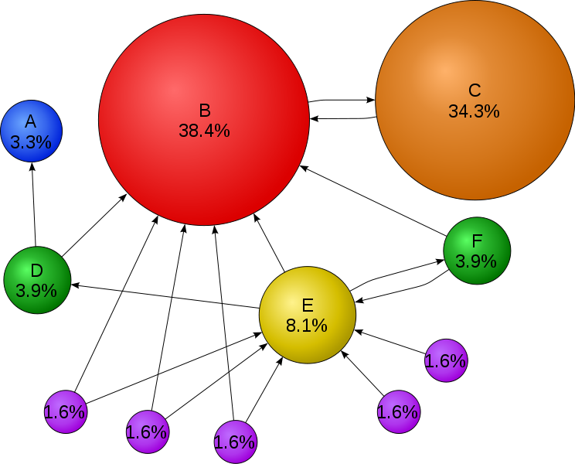
Micro-scale level analysis
Other centrality measures: eigenvector centrality, Katz centrality, Estrada centrality, percolation centrality, ...
PageRank algorithm, Google, 1998.

Slide 16
Part II:Scientific collaboration networks– preliminary results

Slide 17
Scientific collaboration networks
What can we find out about scientific collaboration using the network analysis?
To see intensity of the collaborations and connections between scientists (dense or rare)
To identify communities of scientists
To find who are the influential scientists
To find who are the “bridges” between different communities
To compare the collaboration on various institutions
To measure the quality of collaborations

Slide 18
Experiment setup
Colecting the data: CROSBI (bib.irb.hr)
Department of Informatics
Department of Mathematics
Department of Biotechnology
Faculty of Humanities and Social Sciences
...
Data cleaning
Constructing 5 weighted networks: KOA_{INF}, KOA_{MAT}, KOA_{BIO}, KOA_{FFRI}, KOA_{INT}
Network analysis

Slide 19
Data
bib.irb.hr

Slide 20
Results
 | KOA_{INF} | KOA_{MAT} | KOA_{BIO} | KOA_{FFRI} | KOA_{INT}
Number of nodes | 90 | 44 | 182 | 909 | 1150
Number of links | 177 | 84 | 976 | 2735 | 3862
Average degree | 3,933 | 3,818 | 10,725 | 6,02 | 6,687
Maximal degree | 22 | 9 | 110 | 64 | 110
Average strength | 7 | 6,227 | 15,209 | 9,013 | 9,974
Average path length | 3.6 | 1.485 | 2.438 | 5.87 | 5.583
Diameter | 8 | 3 | 5 | 16 | 16
Clustering coefficient | 0,759 | 0,897 | 0,897 | 0,797 | 0,813
Density | 0,044 | 0,089 | 0,059 | 0,007 | 0,006
Modularity | 0,658 | 0,796 | 0,550 | 0,891 | 0,892
Number of communities | 7 | 8 | 11 | 63 | 69
Number of components | 2 | 8 | 5 | 49 | 54

Slide 21
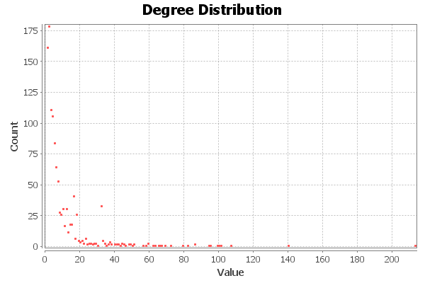
Results
Degree distribution of integral network

Slide 22
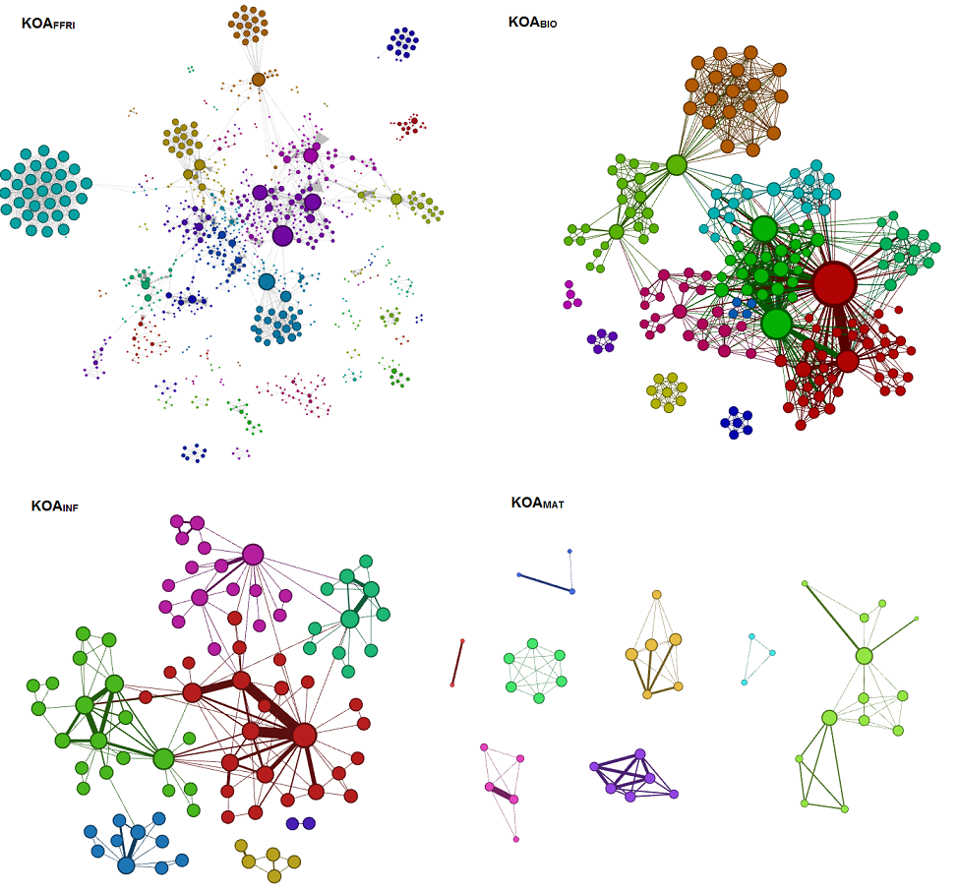
Results

Slide 23
Collaboration network Department of Informatics

Slide 24
Collaboration network Department of Mathematics

Slide 25
Collaboration network Department of Biotechnology

Slide 26
Collaboration network Faculty of Humanities and Social Sciences

Slide 27
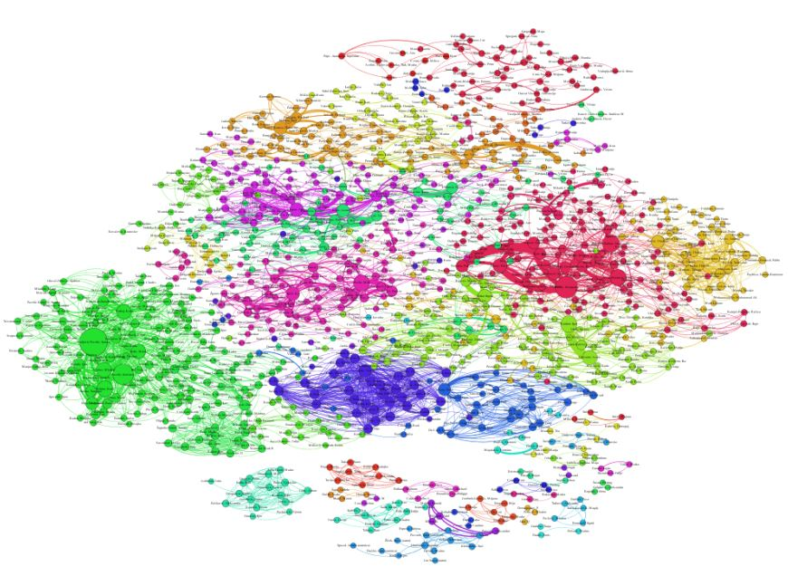
Collaboration network University of Rijeka

Slide 28
Centrality measures
Node | Degree centrality | Node | Closeness centrality | Node | Betweenness centrality
A1 | 213 | B1 | 11,7 | C1 | 77625
A2 | 140 | B2 | 10,77 | C2 | 59712
A3 | 107 | B3 | 10,765 | C3 | 49505
A4 | 101 | B4 | 10,765 | C4 | 47361
A5 | 100 | B5 | 10,765 | C5 | 41155
A6 | 99 | B6 | 10,765 | C6 | 35369
A7 | 95 | B7 | 10,76 | C7 | 30055
A8 | 94 | B8 | 10,76 | C8 | 29307
A9 | 86 | B9 | 10,76 | C9 | 25555
A10 | 86 | B10 | 10,757 | C10 | 25465

Slide 29
Conclusion and future work
Complex networks analysis have the potential to give insight into the quality of the scientific collaboration.
Future work:
collect data for all constituents at the University of Rijeka
compare scientific collaboration of all constituents
quantify the quality of the collaboration by using complex network measures

Slide 30
Scientific collaboration networks at the University of Rijeka
Ana Meštrović, Slobodan Beliga, Sanda Martinčić-Ipšić
Department of Informatics
University of Rijeka
15th Workshop on “Software Engeneering Education and Reverse Engineering”
Bohinj, Slovenia, 23th-30th August 2015

